Slide 1
Image Classification with Deep Learning
hackEvolve saideeptalari@gmail.com
http://hackevolve.com

Slide 2
Note
The images used in this presentation are solely taken for educational purposes and it belongs to their respective owners

Slide 3
Image Classification with Deep learning

Slide 4
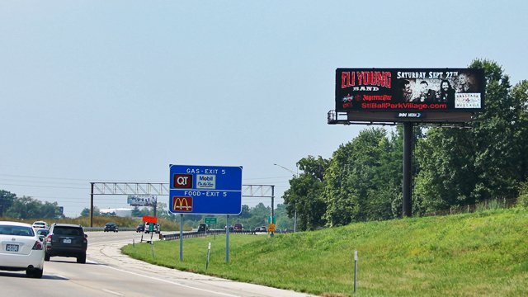
Image Classification with Deep learning

Slide 5
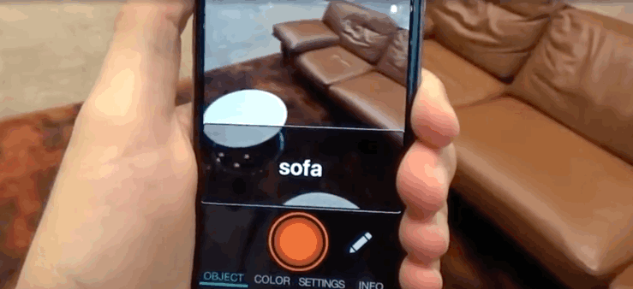
Aipoly

Slide 6
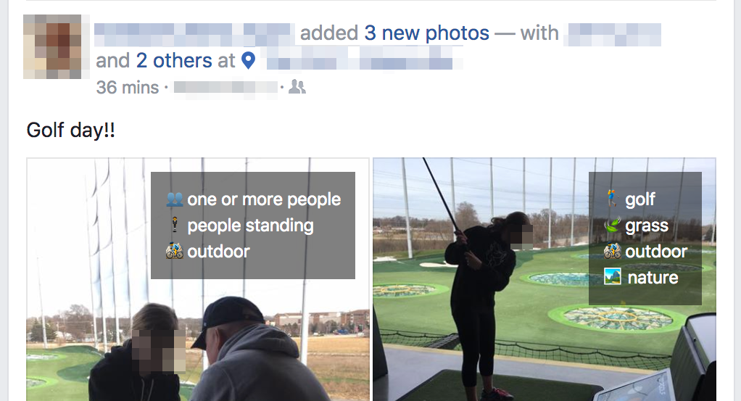
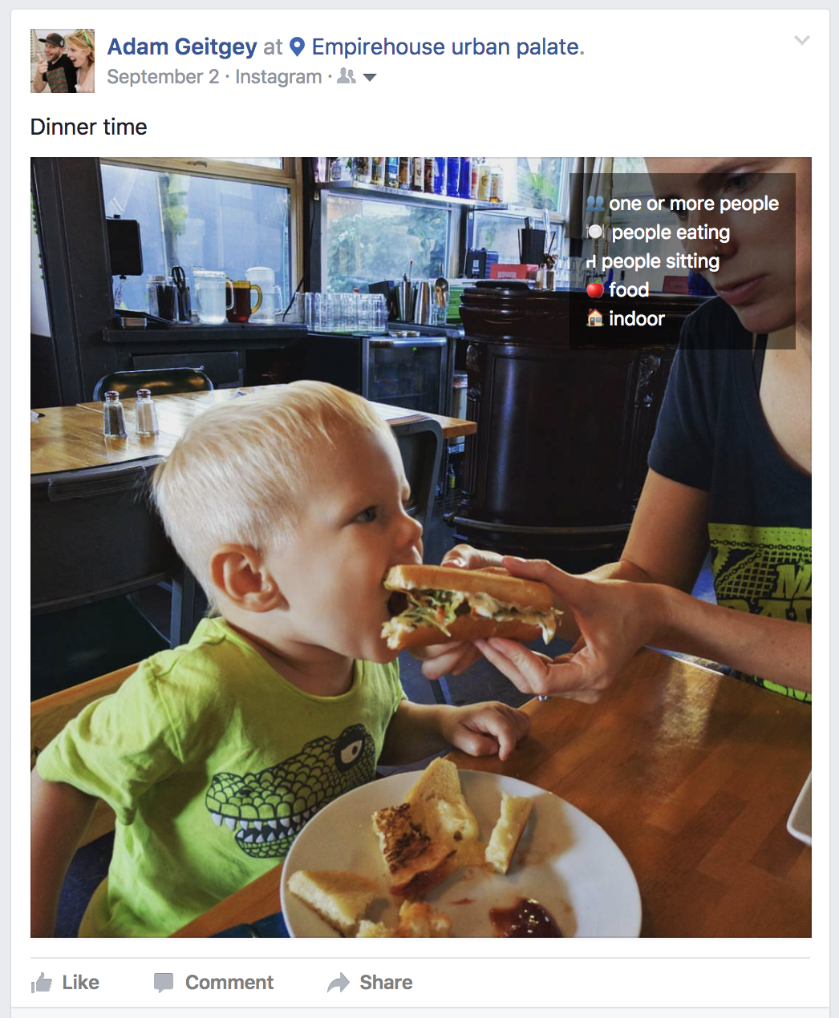
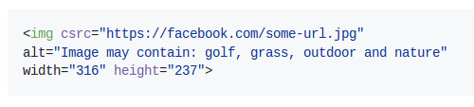
Facebook Computer Vision tags
https://github.com/ageitgey/show-facebook-computer-vision-tags

Slide 7
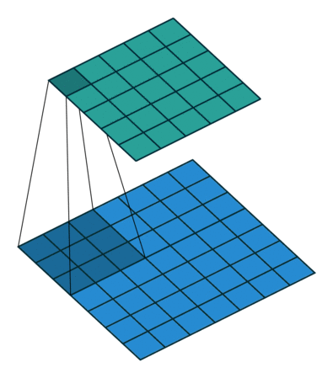
Quick refresher on CNN
http://cs231n.github.io/

Slide 8

Convolution
W_{o} = ((W_{i}-F+2P)/S) + 1

Slide 9
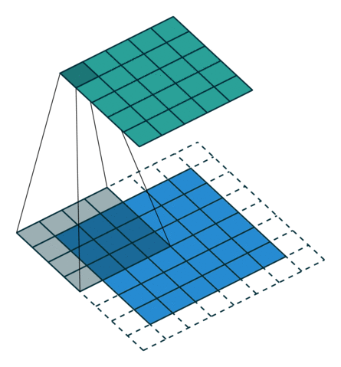
Padding

Slide 10
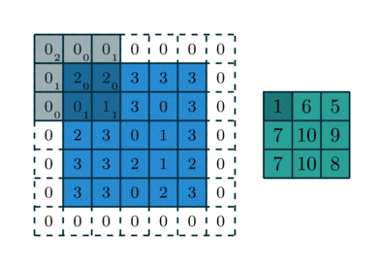
Strides

Slide 11
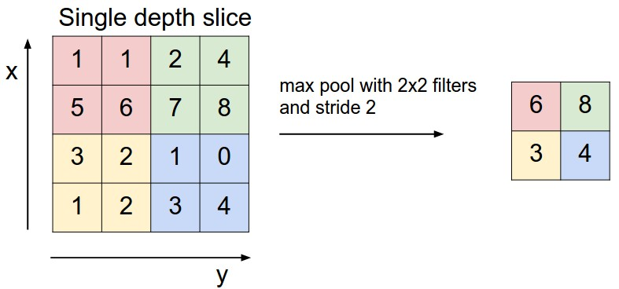
Maxpooling

Slide 12
General Architectures
Convolution
Convolution
Activation
Maxpool
Maxpool
Activation

Slide 13
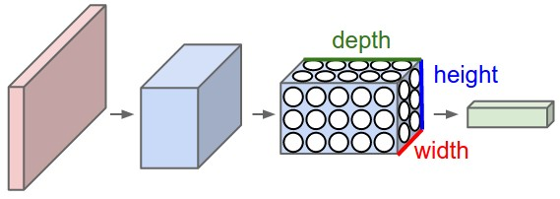
General Architectures

Slide 14
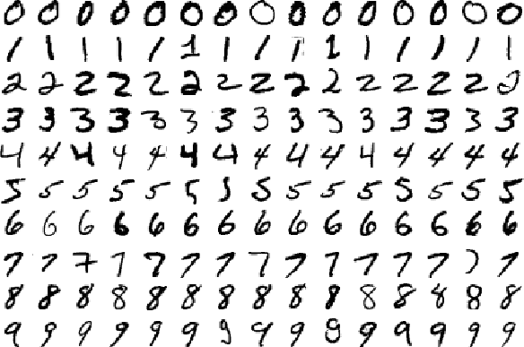
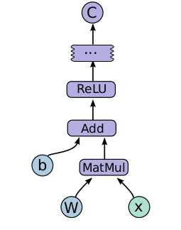
Tensorflow & MNIST

Slide 15
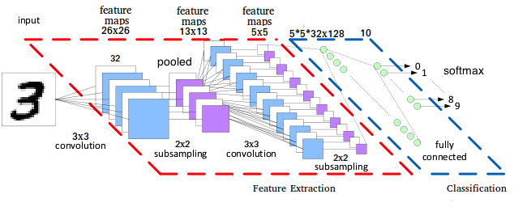
MNIST model

Slide 16
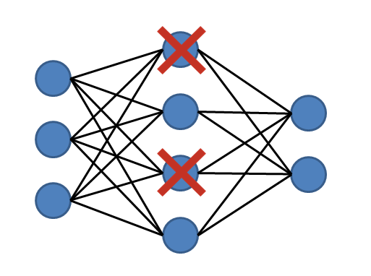
Dropout

Slide 17
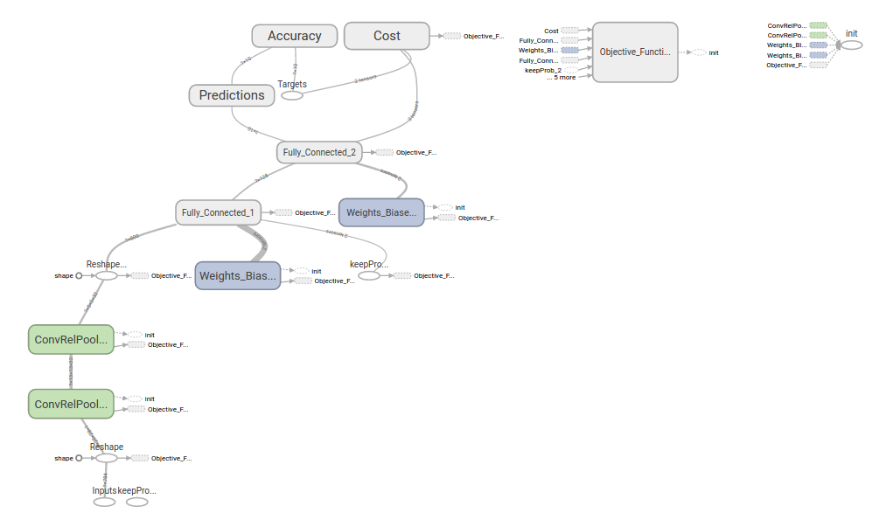
MNIST model

Slide 18
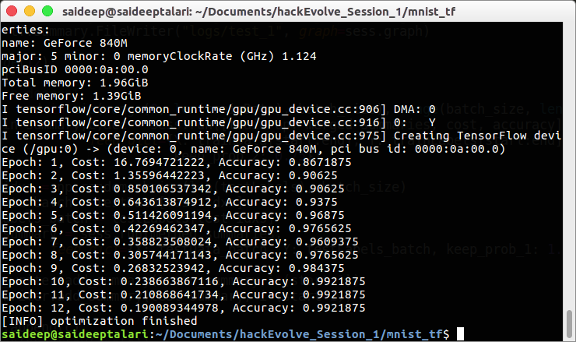
MNIST results

Slide 19
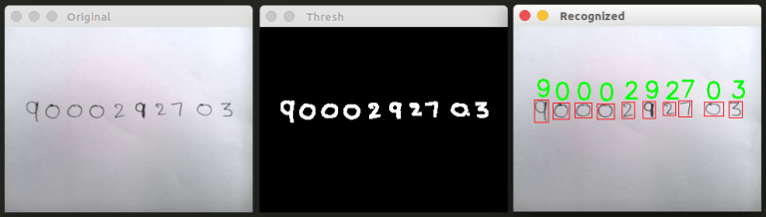
Handwritten digits Recognition
http://hackevolve.com/recognize-handwritten-digits-1/

Slide 20
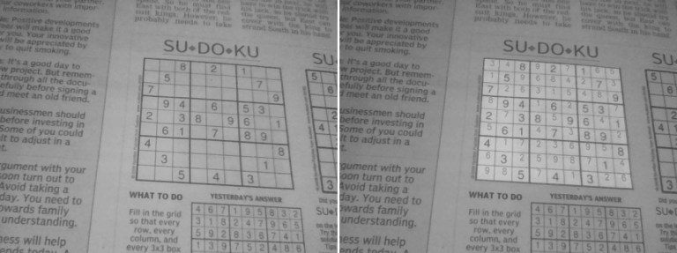
Sudoku Solver
http://hackevolve.com/sudoku-solver-1/

Slide 21
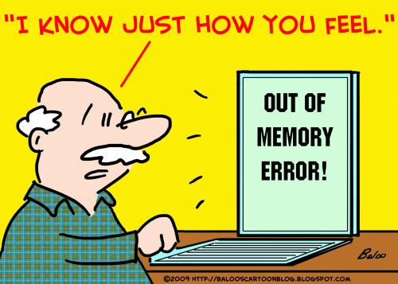
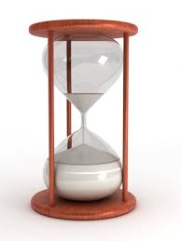
Challenges in training a Deep learning model

Slide 22
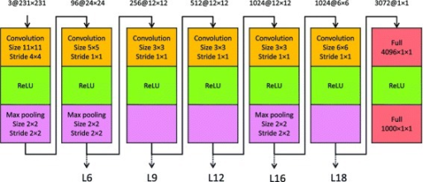
Using a pre-trained model (OverFeat)

Slide 23
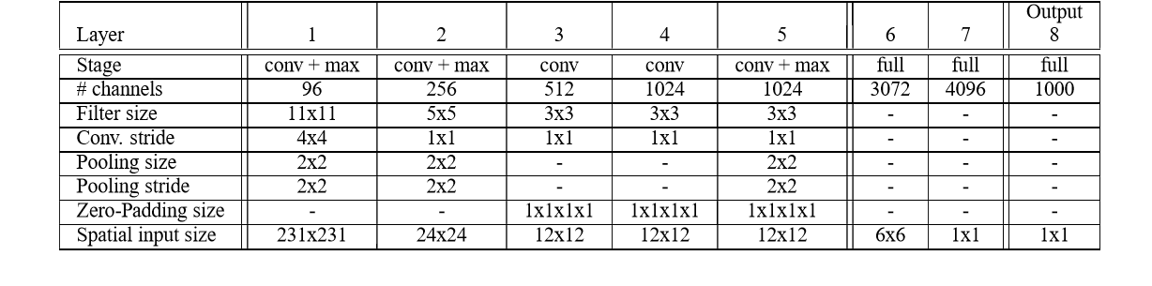
OverFeat Architecture

Slide 24
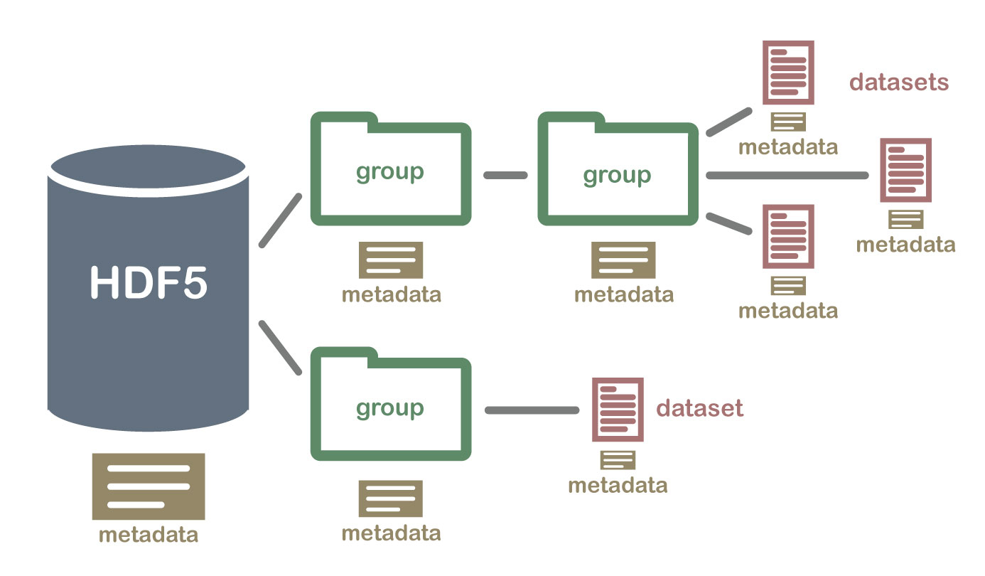
Why use HDF5 ?

Slide 25
Extracting features to HDF5

Slide 26
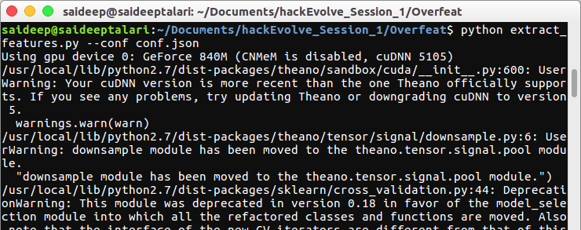
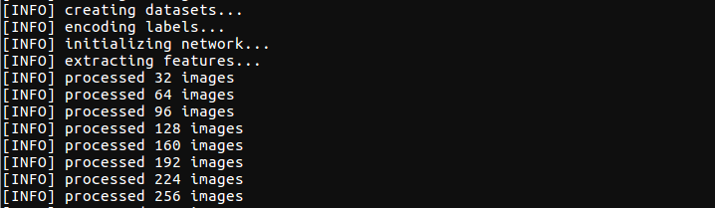
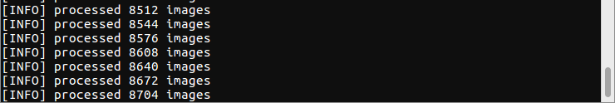
Extracted features...

Slide 27
Using Extracted Features

Slide 28
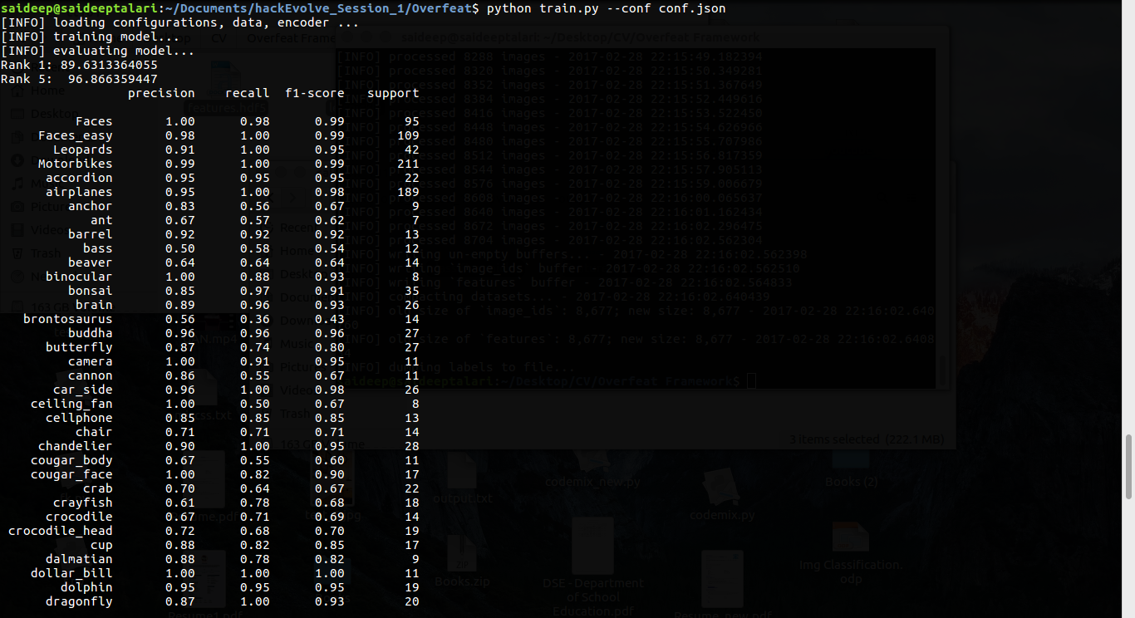
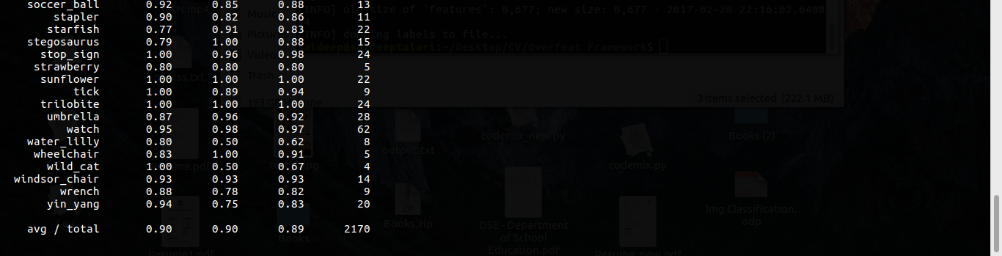
Trained model...

Slide 29
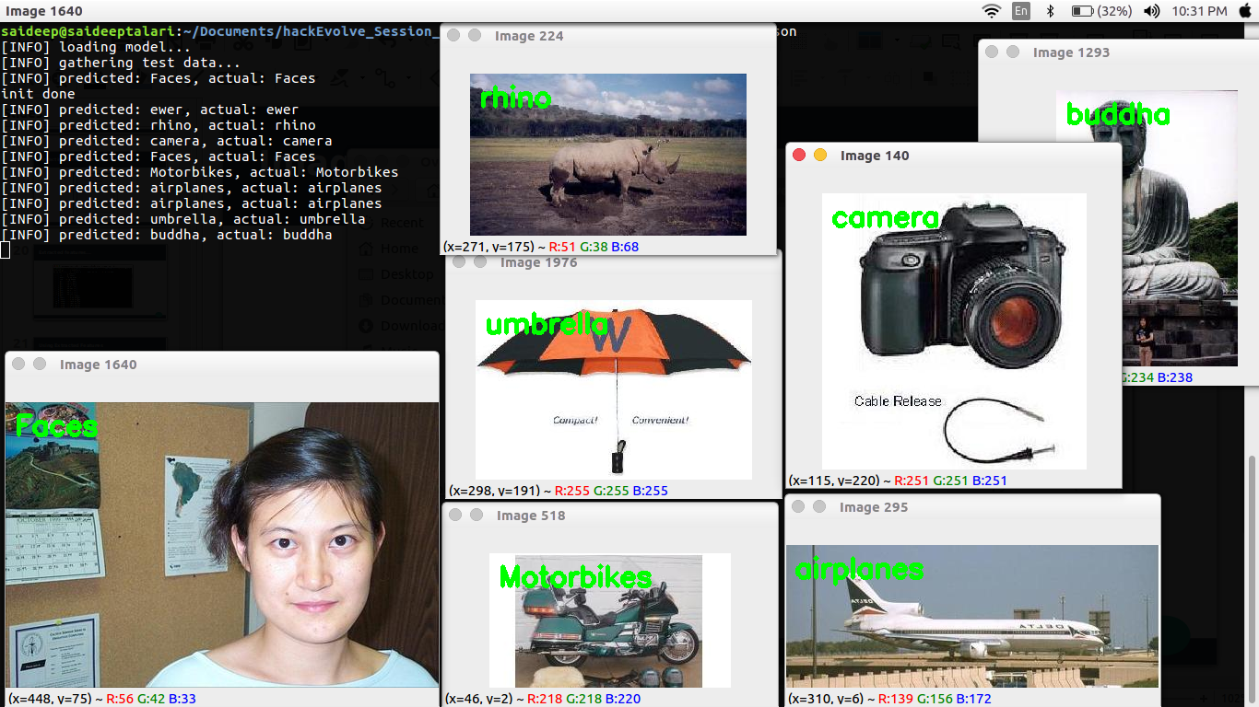
Testing our model...

Slide 30
CNNs can also be like...
Conv_1
FC_1
Conv_2
FC_2
Output
Conv_3
FC_3
Conv_4

Slide 31
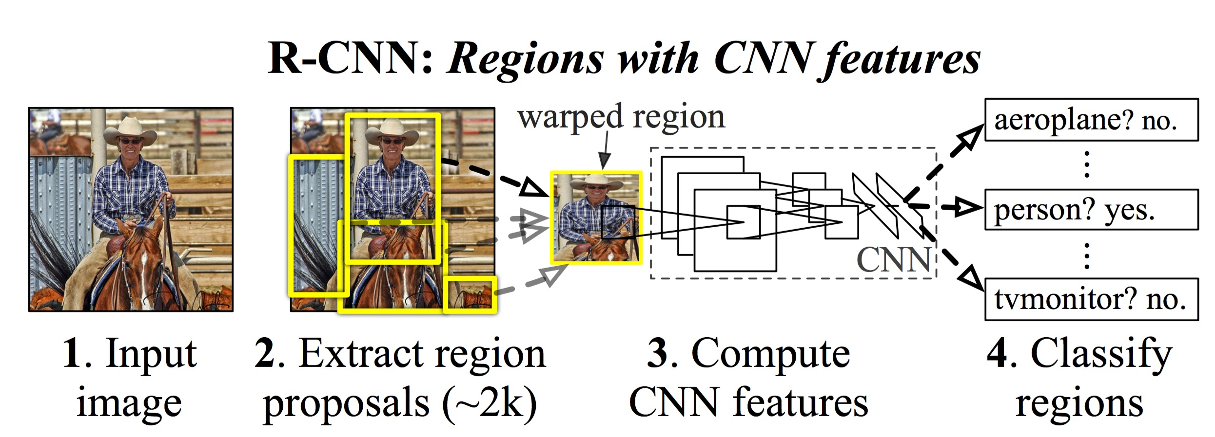
RCNNs

Slide 32
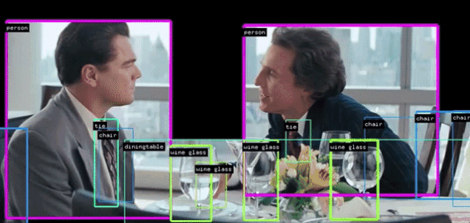
Object detection using RCNN

Slide 33
Image Classification with Deep learning

Slide 34
Image Classification with Deep learning

